Slide 1
Quantitative Analysis of Bone Regenerated Using Patient Specific 3D Printed Scaffolds
Intern: Adeeb Hossain
Mentor: Dr. David Margolis, University of Arizona
Space Grant Symposium, Arizona State University
April 22nd, 2023

Slide 2
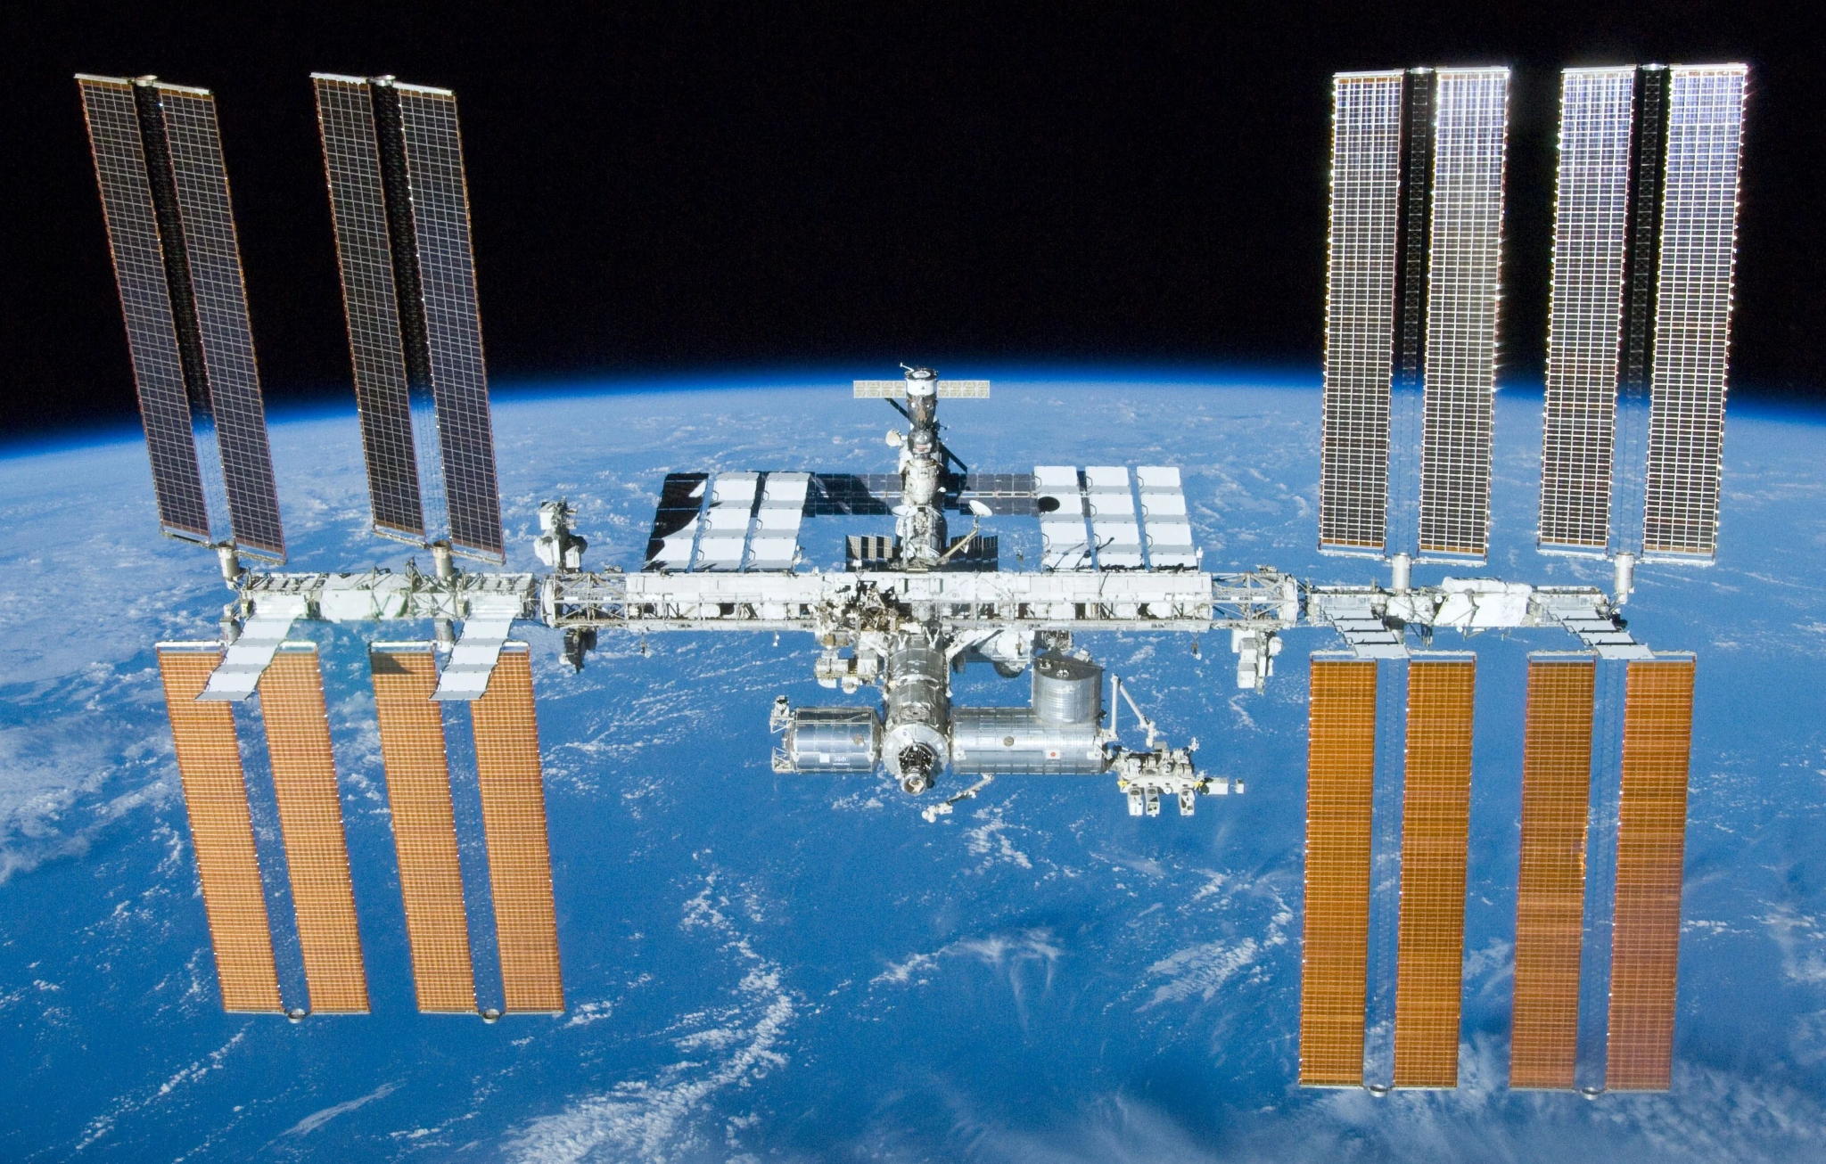
What is the Problem?
Limited resources in space
Injuries can be left inadequately treated
How do we treat bone injuries with limited resources?

Slide 3
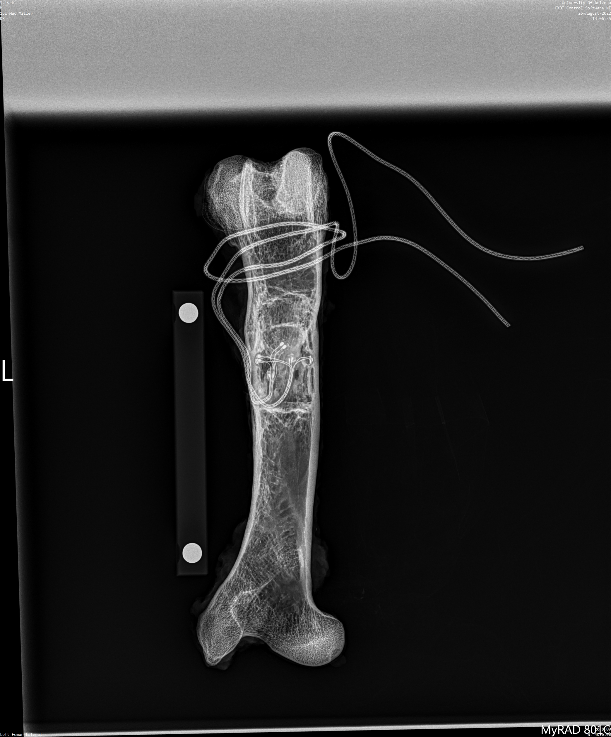
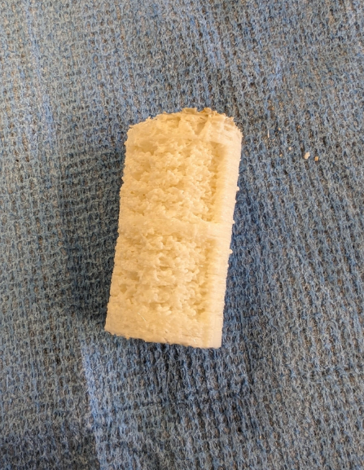
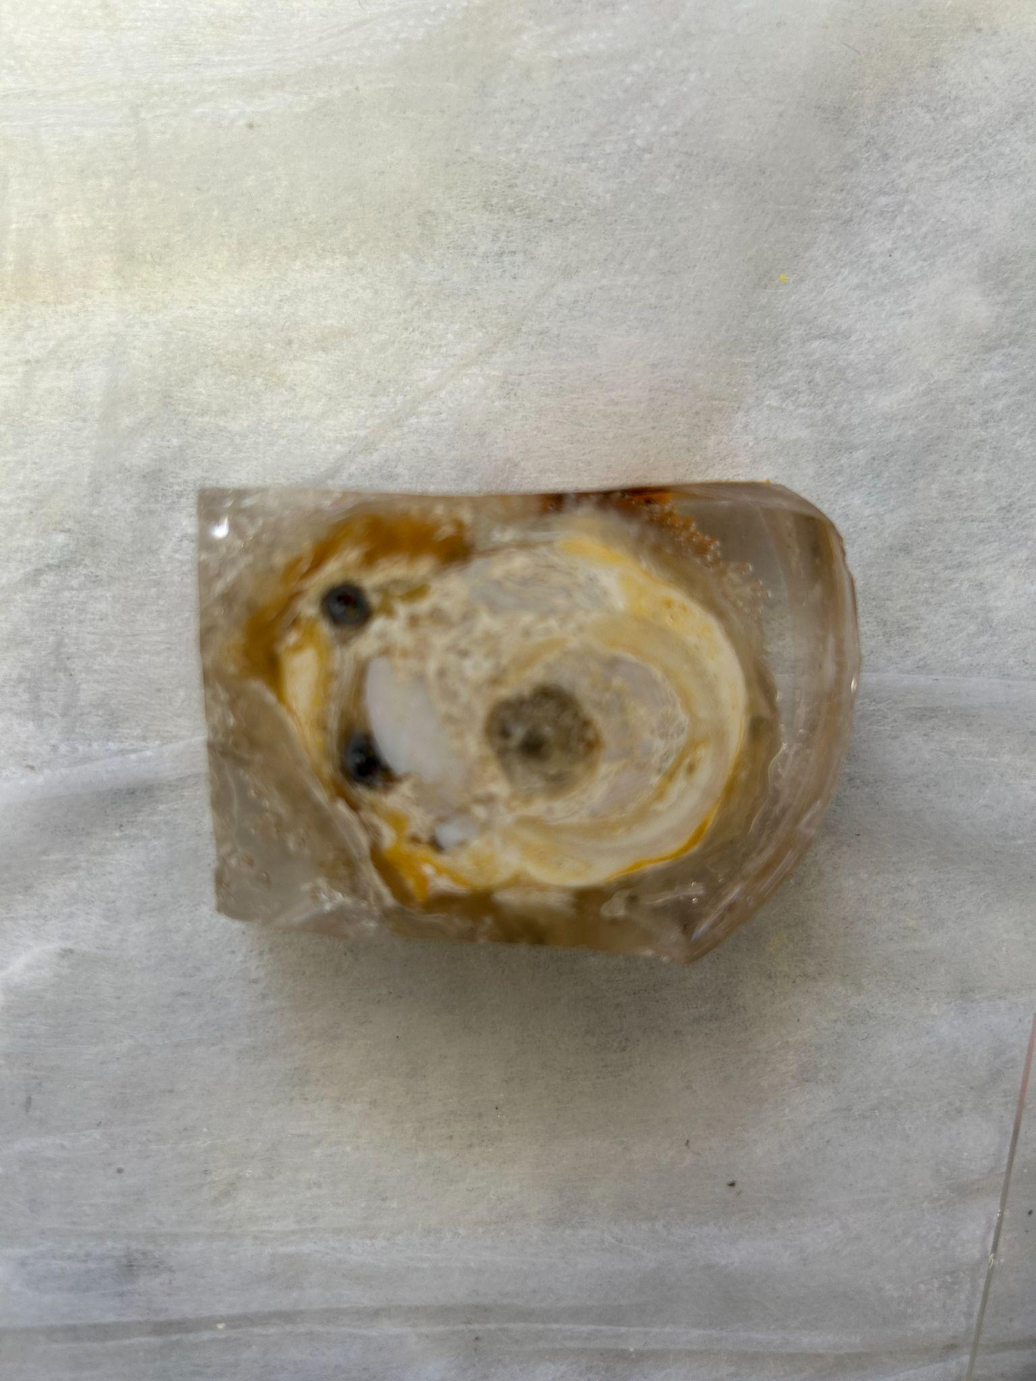
Objectives
Treating large bone defects
Implant 3D printed scaffolds specific to fracture site
Mechanical testing and CT imaging
Histology of bone formation

Slide 4
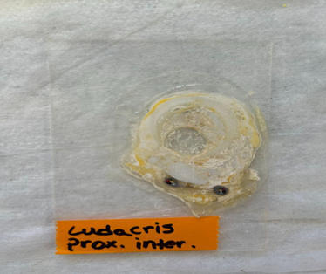
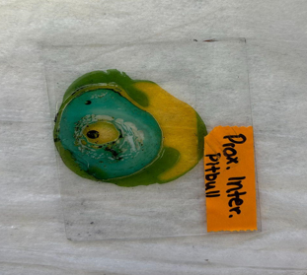
Methodology
Hard Tissue Histology
Slide Staining
Notes:
Saw cutting treatment samples
Gluing cross-section onto imaging slide
Polishing sample surface for uniform surface

Slide 5
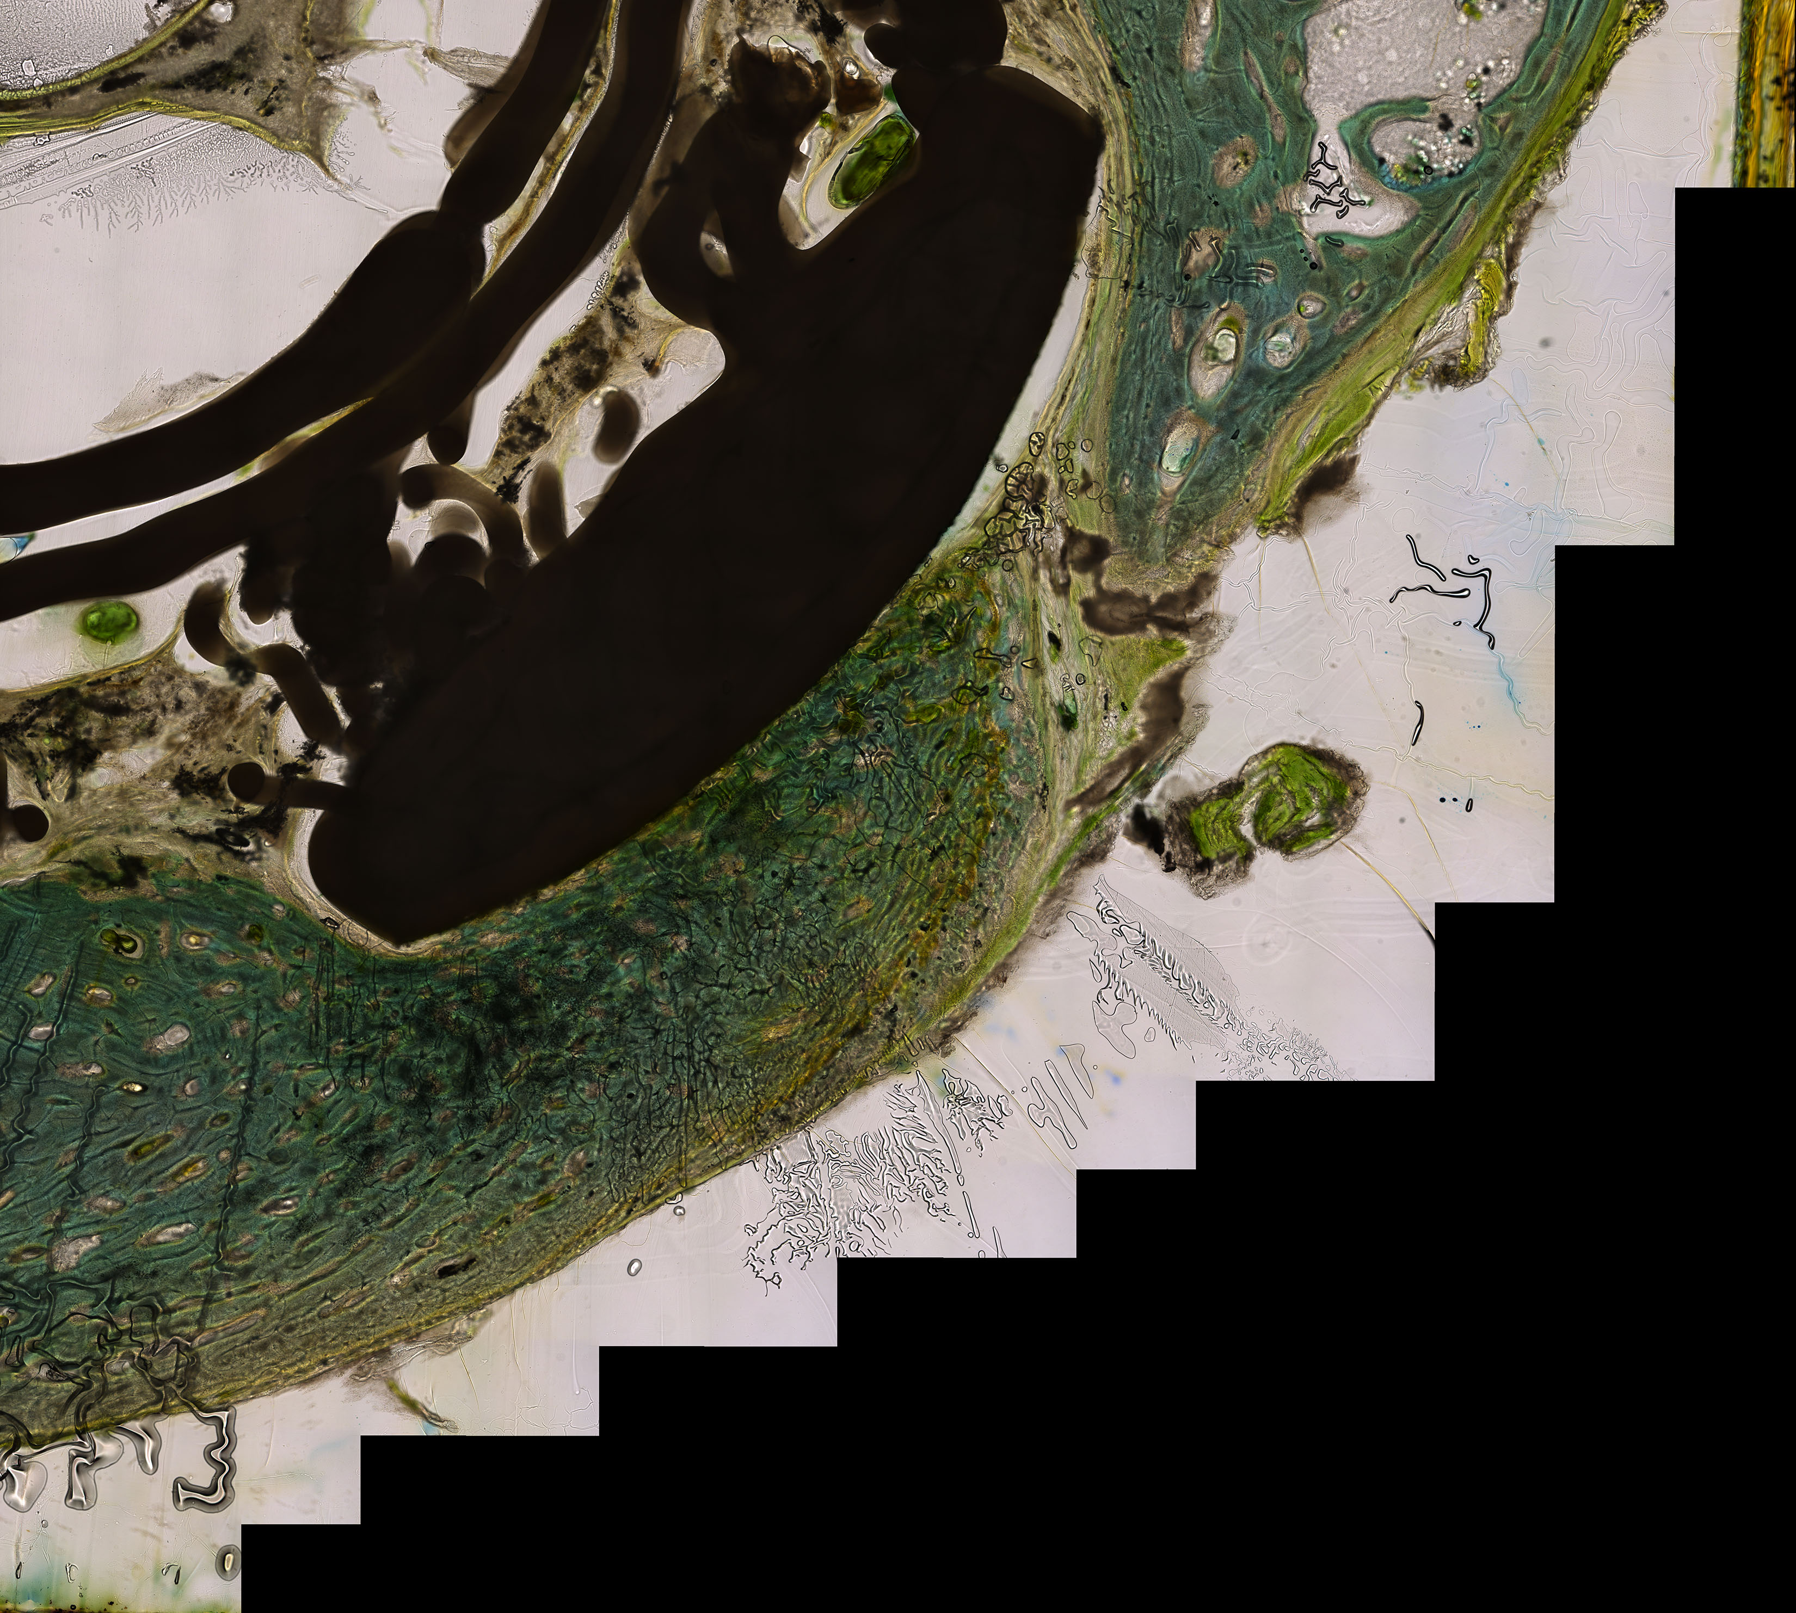
Methodology
Microscopic Imaging
Leica DMI6000 microscope
Capture fluorescent and brightfield images
Image Analysis
Application of ImageJ software
Color thresholding
Notes:
Leica DMI6000 microscope
Capture fluorescent and brightfield images
Programmed stitching to create full image of cortical bone
Application of ImageJ software
Color thresholding
Calculate rate of bone growth (cortical bone / total bone growth)

Slide 6
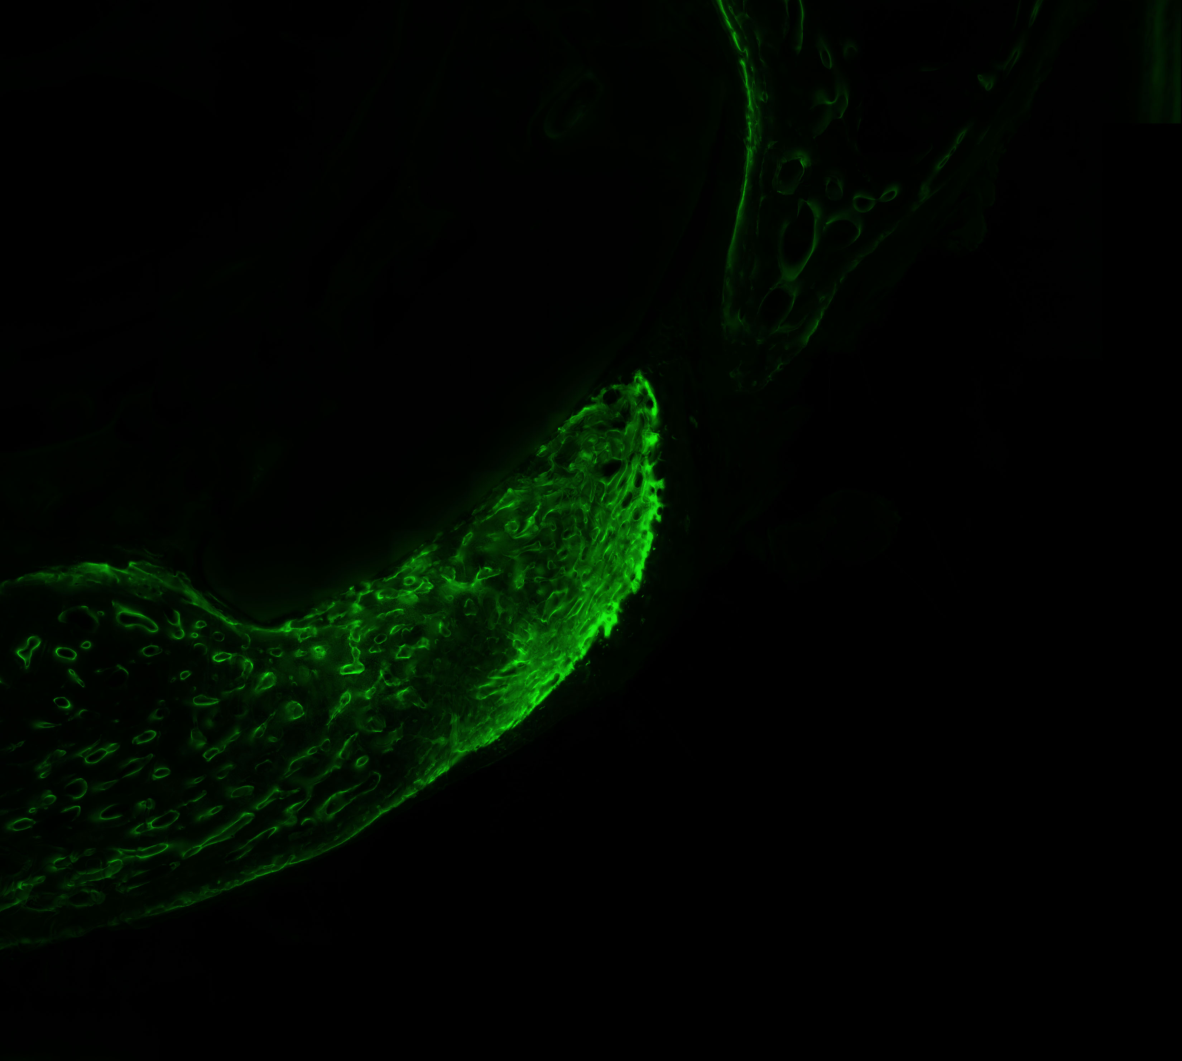
Methodology
Microscopic Imaging
Leica DMI6000 microscope
Capture fluorescent and brightfield images
Image Analysis
Application of ImageJ software
Color thresholding
Notes:
Leica DMI6000 microscope
Capture fluorescent and brightfield images
Programmed stitching to create full image of cortical bone
Application of ImageJ software
Color thresholding
Calculate rate of bone growth (cortical bone / total bone growth)

Slide 7
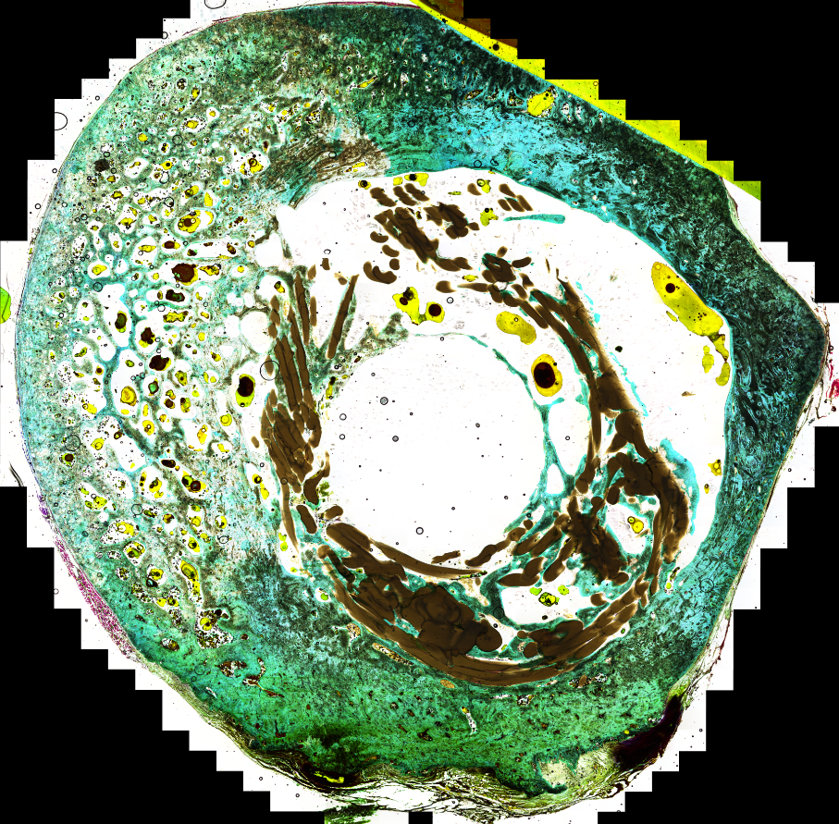
Anticipated Results
Total Bone Growth:
1.89 cm^2

Slide 8
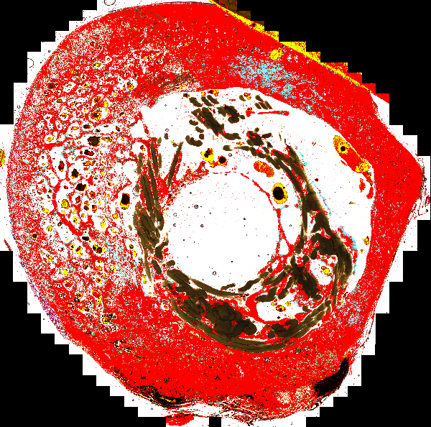
Anticipated Results
Total Bone Growth:
1.89 cm^2

Slide 9
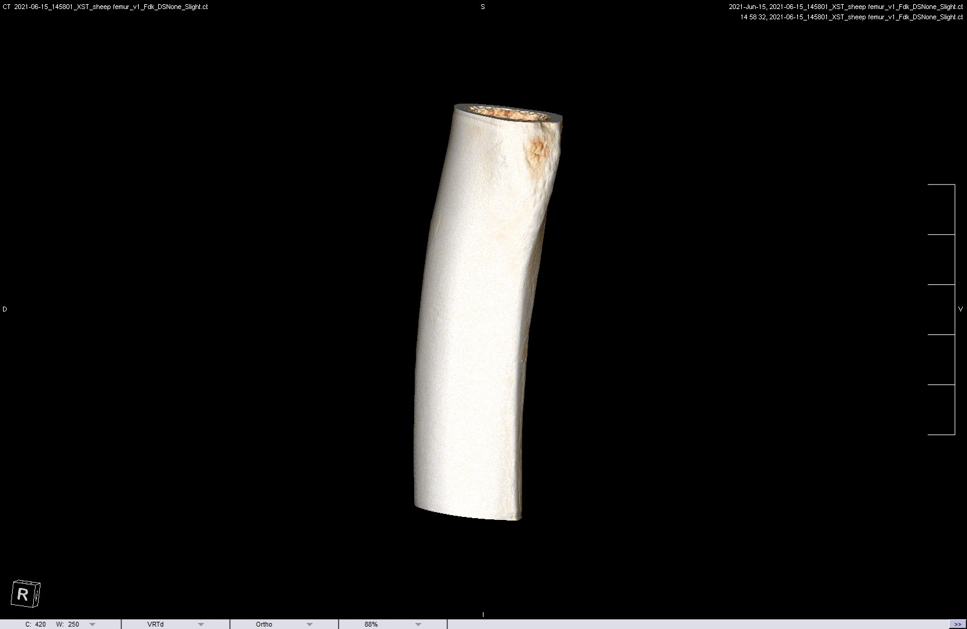
Anticipated Results

Slide 10
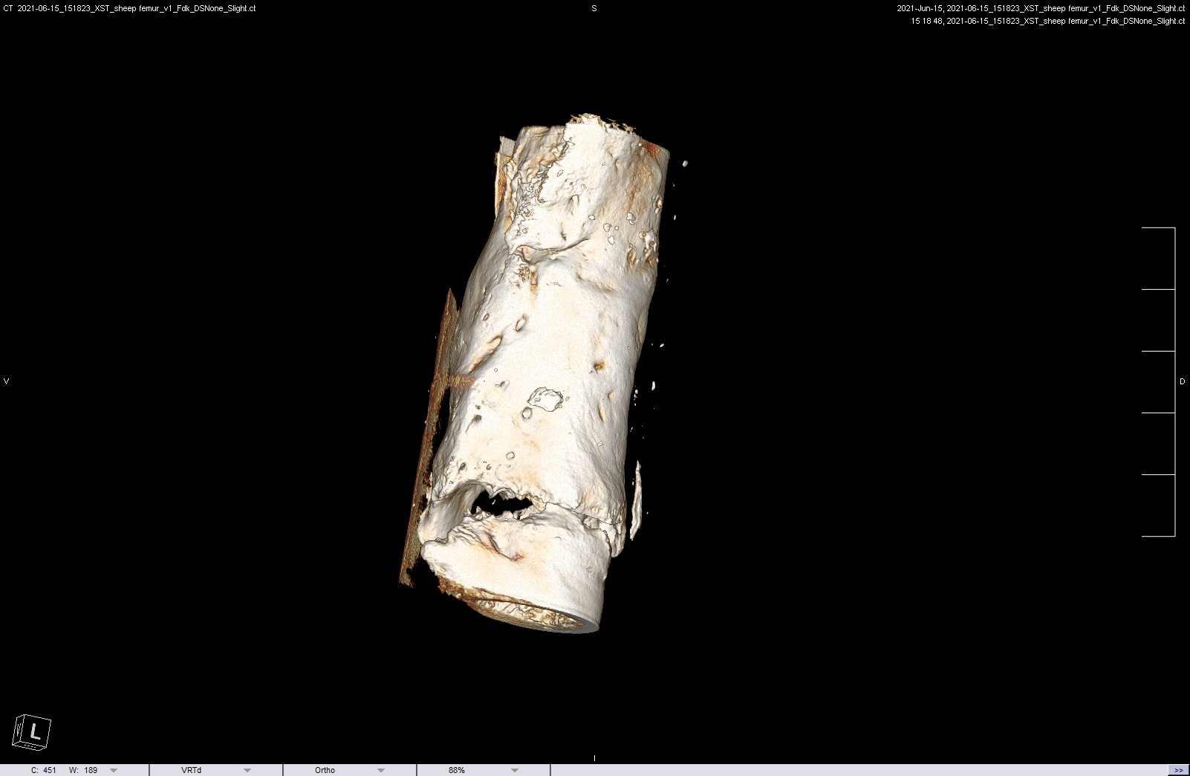
Anticipated Results

Slide 11
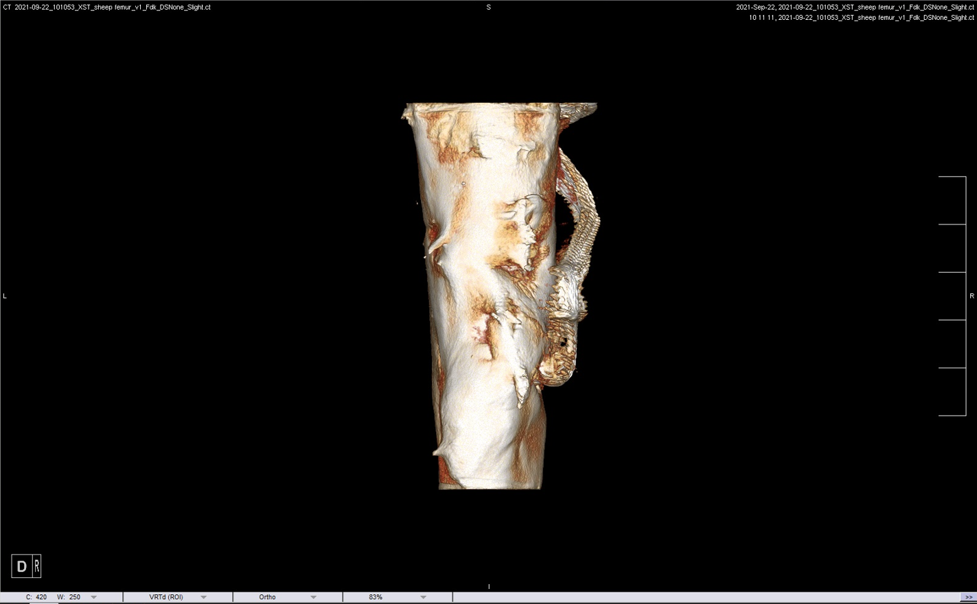
Anticipated Results

Slide 12
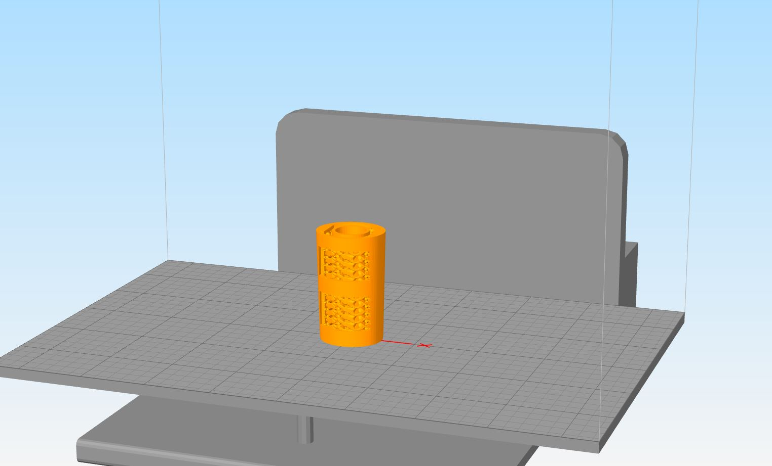
Significance
Addresses resource scarcity to treat fractures
General use to treat fractures
Faster healing times for fractures
Reduce cost of treating fractures

Slide 13
Thank You
Special Acknowledgements to….
Dr. David Margolis (PI)
David Gonzales (lab manager)
University of Arizona
NASA Space Grant

